Slide 1
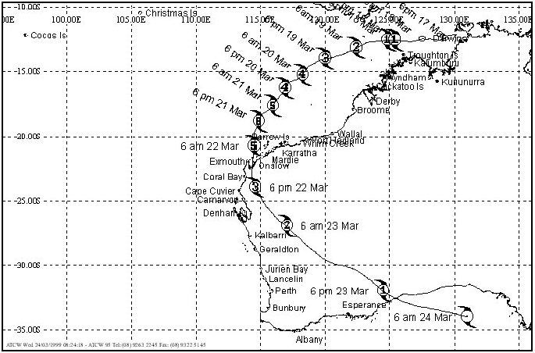
Residential timber framed construction (AS 1684 Part 1 to 4)
Tropical Cyclone Vance – Damage to Buildings in Exmouth
22 March 1999 Tropical Cyclone Vance struck the north-west town of Exmouth

Slide 2
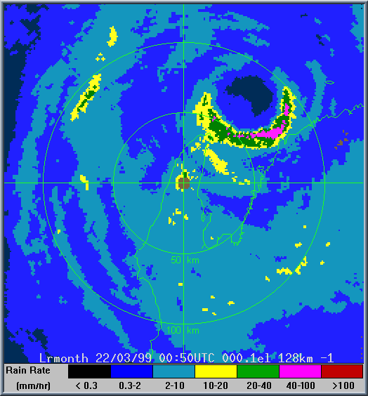
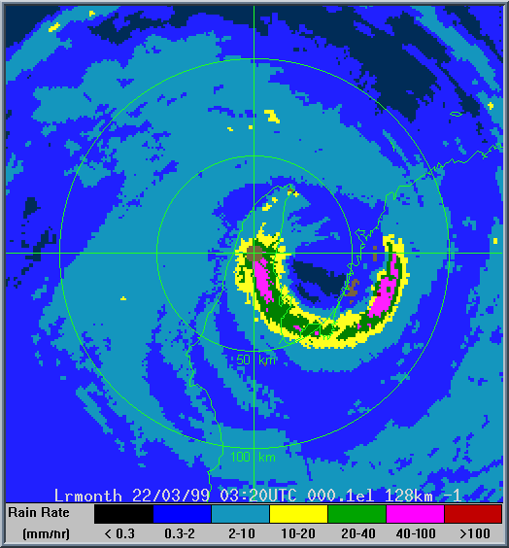
Tropical Cyclone Vance – Damage to Buildings in Exmouth
For more information on this matter refer to Report
Tropical Cyclone Vance – Damage to Buildings in Exmouth
Photos courtesy Assoc Prof Geoff Boughton

Slide 3
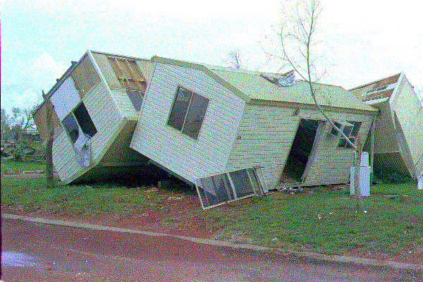
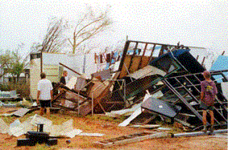
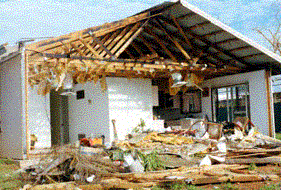
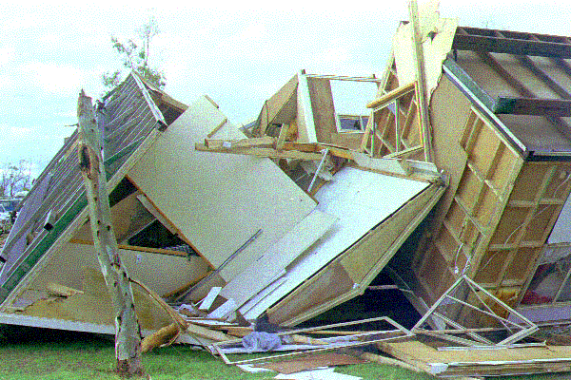

Slide 4
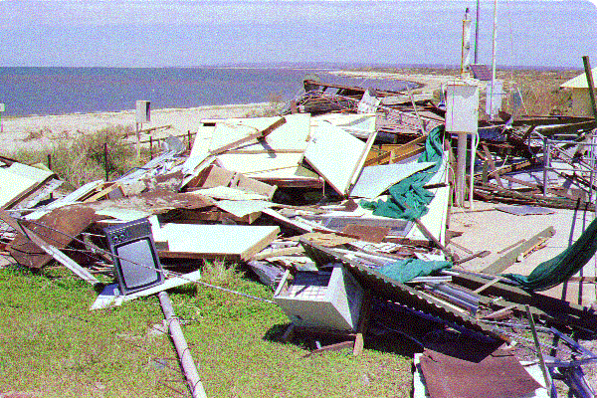
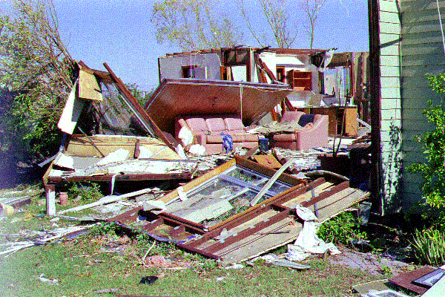
How can this be avoided?
Timber framing depends very much on the proper connection design.
The load path must be continuous followed up into the footing and foundation
AS 1684.2-3 Section 9 (Fixing)

Slide 5
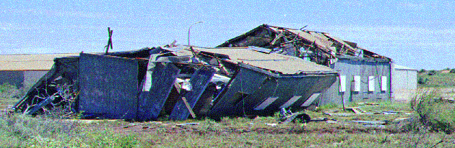
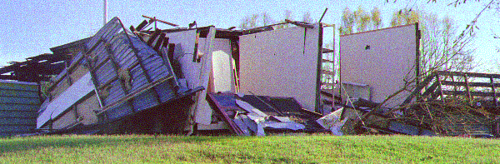

Slide 6
